Slide 1

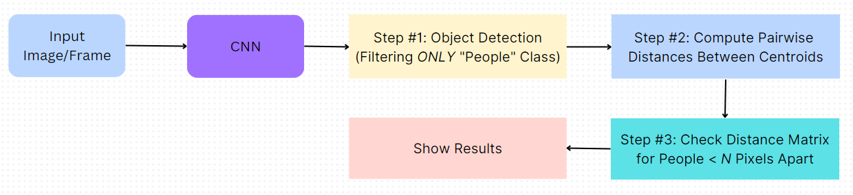
Social Distance Monitoring System
Aathithya, Achanta Sai Krishna, Mohamed Aathil, Krishna Prasath
Department of EEE, Amrita School of Engineering, Amrita Vishwa Vidyapeetham , Coimbatore – 641112, Tamil Nadu, India
ABSTRACT
METHODS
SUMMARY
In the fight against the COVID-19,social distancing has proven to be a very effective measure to slow down the spread of the disease.
People are asked to limit their interactions with each other, reducing the chances of the virus being spread with physical or close contact.
In past deep learning has shown promising results on a number of daily life problems.
In this proposed system we will see the detailed explanation of how we can use Python, Computer Vision and deep learning to monitor social distancing at public places and workplaces.
To ensure social distancing protocol in public places and workplace, the social distancing detection tool that can monitor if people are keeping a safe distance from each other by analyzing real time video from the camera.
Monitoring People at workplaces, factories, shops we can integrate this tool to their security camera systems and can monitor whether people are keeping a safe distance from each other or not.
1. Importing the necessary libraries
Cv2
Imutils
Datetime
Numpy
Math
2. Setting up the MobileNet SSD model:
The protopath and modelpath variables specify the network layers and contains to the model weights.
The cv2.dnn.readNetFromCaffe function is used to load the model from the files
3. Defining a list of classes:
The CLASSES list contains the names of different classes that the model can detect, including "person" for human detection.
4. Defining the Centroidcode class:
This class is used to track objects based on their centroids.
The class has methods for registering, deregistering, and updating objects.
5. Defining the non_max_suppression_fast function:
This function performs non-maximum suppression to filter out overlapping bounding boxes.
It takes a list of bounding boxes and an overlap threshold as input and returns the selected bounding boxes.
6. Defining the main function:
This is the main logic of the social distancing monitoring system.
It starts by capturing the video using cv2.VideoCapture.
It loops through the frames of the video, performs object detection using the MobileNet SSD model, and tracks the detected objects' centroids.
It checks for violations of social distancing rules by calculating the distances between pairs of centroids and determines whether they are within a certain threshold.
It draws bounding boxes around the objects and displays the frame with relevant information.
It also calculates and displays the frames per second (FPS) of the video.
This program utilizes image processing and machine learning techniques to develop a social distance monitoring system. It reads video frames, detects individuals using a pre-trained model, and tracks their positions over time. By calculating the distance between tracked individuals, the program identifies violations of social distancing guidelines and marks them accordingly. Each surveillance frame is also accompanied with the streamline plot depicting the statistical count of the number of peoples with index term ,count number of peoples violated and frame count . The program offers visualization of bounding boxes and IDs on the frames, facilitating easy identification. Warning is displayed if combination is not following social distancing . It provides real-time monitoring and serves as a valuable tool for ensuring public health and safety by promoting social distancing practices.
CONCLUSIONS
In conclusion, social distance monitoring using image processing and machine learning provides an innovative and efficient solution to ensure compliance with social distancing guidelines. By automating the detection and tracking of individuals in real-time, this technology offers real-time alerts and warnings, promoting responsible behavior and minimizing the spread of contagious diseases. Implementing such systems can significantly contribute to public health and safety, making our communities safer and more resilient.
OBJECTIVE
The objective of our project is to implement a reliable and effective Social Distance Monitoring System which helps to warn the users if they are very close to another person. This helps to reduce the spread of diseases and viruses like Corona.
Simpler to separate people who are not following social distancing from those who are following by coloring their bounding box as red and green respectively.
Distance between each combination of people is calculated.
REFERENCES
[1]. S. Suryadi, E. Kurniawan, H. Adinanta, B. H. Sirenden, J. A. Prakosa and P. Purwowibowo, "On the Comparison of Social Distancing Violation Detectors with Graphical Processing Unit Support," 2020 International Conference on Radar, Antenna, Microwave, Electronics, and Telecommunications (ICRAMET), Tangerang,Indonesia,2020,pp.337-342,doi: 10.1109/ICRAMET51080.2020.9298574. URL:https://ieeexplore.ieee.org/stamp/stamp.jsp?tp=&arnumber=9298574&isnumber=9298568
[2]. N. N. Abu Mangshor, M. N. Rajudin and R. Aminuddin, "Framework for JARAK: A Monitoring and Notifier System for Social Distancing," 2021 IEEE 19th Student Conference on Research and Development (SCOReD), Kota Kinabalu, Malaysia, 2021, pp. 422-426,doi:10.1109/SCOReD53546.2021.9652710. URL:https://ieeexplore.ieee.org/stamp/stamp.jsp?tp=&arnumber=9652710&isnumber=9652588
[3]. M. E. Rusli, S. Yussof, M. Ali and A. A. Abobakr Hassan, "MySD: A Smart Social Distancing Monitoring System," 2020 8th International Conference on Information Technology and Multimedia (ICIMU), Selangor, Malaysia, 2020, pp. 399-403, doi: 10.1109/ICIMU49871.2020.9243569. URL:https://ieeexplore.ieee.org/stamp/stamp.jsp?tp=&arnumber=9243569&isnumber=9243299
[4]. Y. C. Hou, M. Z. Baharuddin, S. Yussof and S. Dzulkifly, "Social Distancing Detection with Deep Learning Model," 2020 8th International Conference on Information Technology and Multimedia (ICIMU), Selangor, Malaysia, 2020, pp. 334-338, doi: 10.1109/ICIMU49871.2020.9243478. URL:https://ieeexplore.ieee.org/stamp/stamp.jsp?tp=&arnumber=9243478&isnumber=9243299
BACKGROUND & METHODS
In response to the COVID-19 pandemic, governments, organizations, and individuals worldwide have implemented various measures to reduce the spread of the virus. One crucial measure is practicing social distancing, which involves maintaining a safe physical distance from others to minimize close contact and potential transmission of the virus.
To ensure compliance with social distancing guidelines in public spaces, there is a need for effective monitoring and enforcement mechanisms. Traditional methods of manual monitoring can be challenging, time-consuming, and prone to errors. Therefore, leveraging computer vision and artificial intelligence techniques has emerged as a promising solution for automated social distancing monitoring.

